Slide 1
Enhancing Social Media Sentiment Analysis with Emojis and Emoticons Embeddings for Mitigating Online Toxicity
Pranshu Choubey
20BAI1069
Guided By: Dr. Sandhya M

Slide 2
Table of Contents
1. | Introduction
2. | Problem Statement
3. | Research Objectives
4. | Proposed System: Introduction, Flowchart, Modules and their Explanation
5. | Implementation with Results
6. | Findings and Discussions
7. | What is to be done next?
8. | Guide Approval Mail
9. | Research Paper Status
10. | References

Slide 3
Introduction
Digital communication is defined by prolific social media, where diverse opinions and expressions flourish, posing a challenge to traditional sentiment analysis, which relies solely on textual cues.
This is particularly apparent in the challenge of precisely identifying nuanced and discerning sentiments in text, especially when incorporating emojis and emoticons with context-dependent and ambiguous meanings.
The idea is to enhance sentiment analysis through a unique embedding method that seamlessly integrates text, emojis, and emoticons into a text-only embedding for sentiment analysis models, preserving the context and significance of emojis/emoticons in the text.
This is followed by inputting the generated embedding into a robust sentiment analysis model equipped to identify and categorize a spectrum of human emotions, transcending the conventional positive, negative, and neutral classifications.

Slide 4
B. Background, Context, and Significance of Study
Background:
Traditional sentiment analysis models encounter challenges in accurately identifying nuanced and context-dependent content, primarily due to their reliance on textual cues.
Context:
The integration of emojis and emoticons with advanced sentiment analysis methodologies enhances the understanding of the emotional landscape, acknowledging the significance of visual elements in communication.
Significance of Study:
This project holds significance in advancing sentiment analysis by incorporating emojis and emoticons embeddings, aiming to develop a robust framework capable of recognizing nuanced emotions often overlooked by text-only models.

Slide 5
Problem Statement
The exponential growth of social media has led to a proliferation of hate speech, dark sentiments, and toxic comments.
Conventional sentiment analysis models, primarily dependent on textual cues, encounter difficulties in precisely discerning the nuanced and context-dependent characteristics of content.
Even those that consider emojis in their analysis often limit classifications to positive, negative, and neutral categories, thereby exhibiting limitations in capturing the diverse and subtle emotional nuances.
This project proposes an innovative embedding approach that seamlessly integrates text, emojis, and emoticons into a unified representation, enhancing sentiment analysis.
The aim is to develop a comprehensive framework capable of identifying and mitigating online toxicity by preserving the context and significance of emojis and emoticons in textual content.

Slide 6
Research Objectives
Develop a novel embedding method seamlessly integrating text, emojis, and emoticons for enhanced sentiment analysis.
Preserve the context and significance of emojis and emoticons in the text-only embedding.
Design and implement a robust sentiment analysis model capable of categorizing a spectrum of human emotions.
Mitigate online toxicity by accurately identifying nuanced sentiments often overlooked by text-only models.
Explore the potential of the developed framework in recognizing hate speech and dark sentiments in social media communication.
Establish the project's contribution to advancing sentiment analysis methodologies through the incorporation of emojis and emoticons embeddings.

Slide 7
Proposed System Introduction:
In response to the challenges posed by the evolving landscape of digital communication, the proposed system aims to revolutionize sentiment analysis by introducing a comprehensive framework that seamlessly integrates text, emojis, and emoticons.
Through a series of carefully designed modules, the system seeks to address the limitations of conventional sentiment analysis models and enhance their capability to discern nuanced sentiments, mitigate online toxicity, and preserve contextual information.
List of Modules:
Embedding Module
Sentiment Analysis Model
Toxicity Identification Module
Context Preservation Module

Slide 8
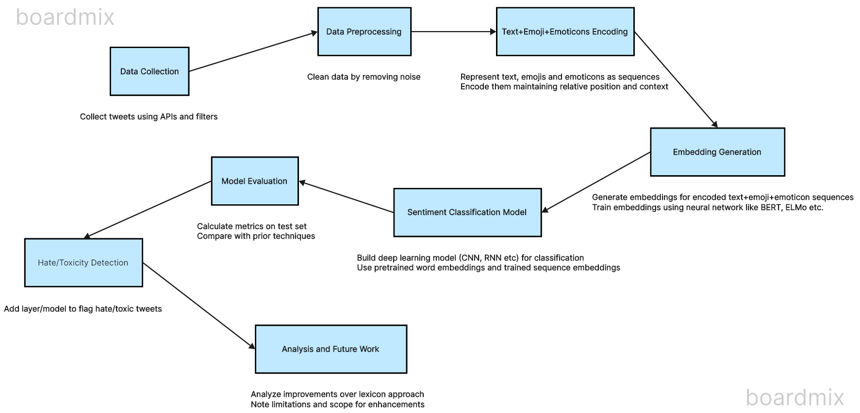
Proposed System Flowchart

Slide 9
Explanation of All Modules:
1. Embedding Module:
Objective: Innovate a novel embedding method that fuses text, emojis, and emoticons into a unified representation.
Methodology: Employ advanced natural language processing (NLP) and deep learning techniques to capture the semantic meaning of textual and visual elements.
Outcome: A seamless embedding capable of conveying nuanced sentiments by preserving the significance of emojis and emoticons.
2. Sentiment Analysis Model:
Objective: Create a robust sentiment analysis model capable of understanding and categorizing diverse human emotions.
Methodology: Implement a deep learning architecture with attention mechanisms to capture contextual nuances, going beyond conventional positive, negative, and neutral classifications.
Outcome: An adaptable model capable of accurately discerning a broad spectrum of emotions in social media content.

Slide 10
3. Toxicity Identification Module:
Objective: Develop a specialized module to identify and flag online toxicity, focusing on hate speech and dark sentiments.
Methodology: Utilize machine learning algorithms trained on datasets enriched with toxic content to recognize patterns indicative of harmful language.
Outcome: An effective module that enhances the overall framework's ability to identify and mitigate toxic expressions in online communication.
4. Context Preservation Module:
Objective: Ensure the preservation of context and significance of emojis and emoticons in the text-only embedding for accurate sentiment analysis.
Methodology: Integrate contextual analysis algorithms to understand the interplay between emojis, emoticons, and surrounding text, capturing nuanced meanings.
Outcome: A module that enriches sentiment analysis by maintaining the integrity of contextual information, allowing for a more nuanced understanding of sentiments expressed in social media content.

Slide 11
Implementation

Slide 12
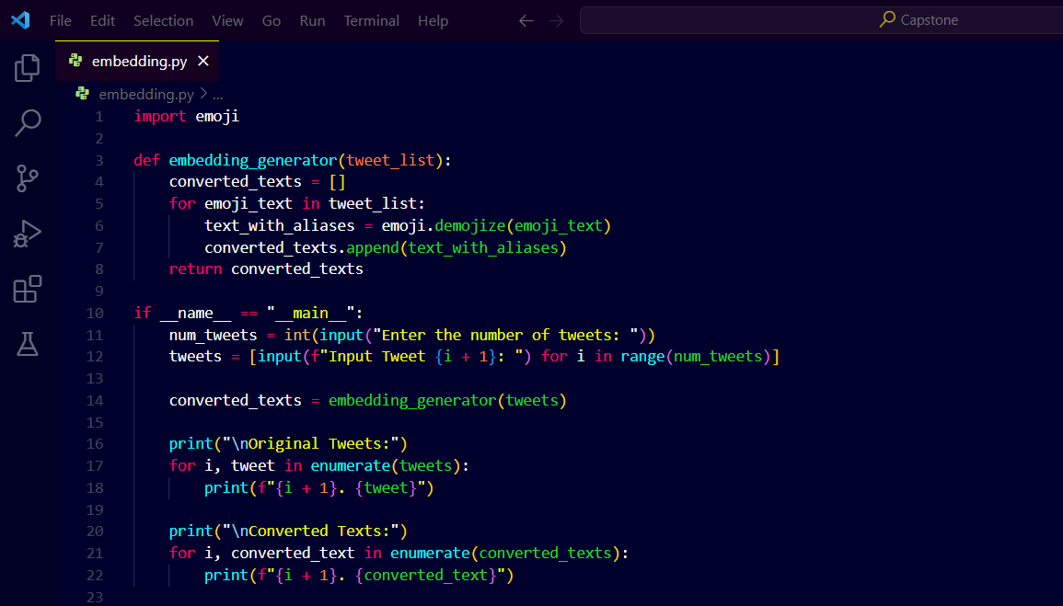
1.1 Embedding Generator Prototype:

Slide 13
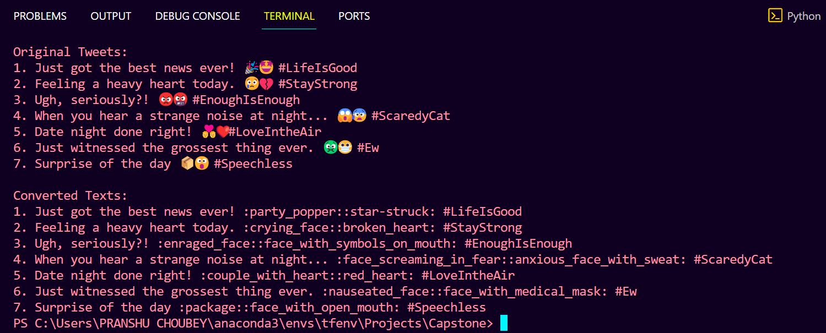
1.2 Embedding Generator Sample Output:

Slide 14
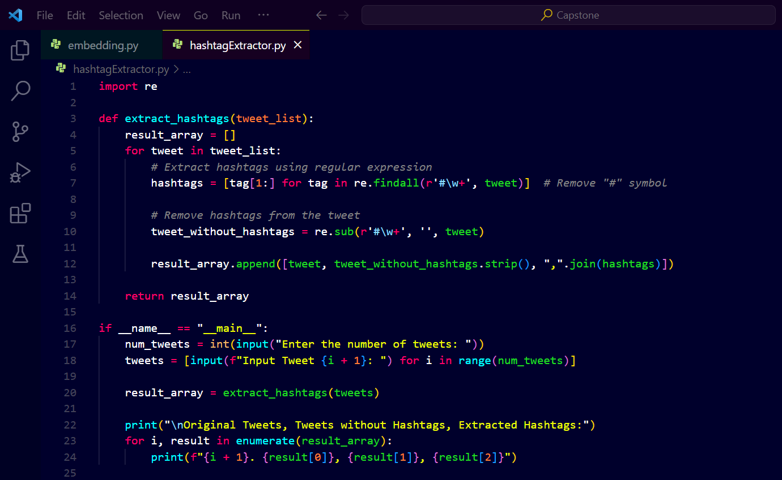
2.1 Hashtag (#) Extractor Prototype:

Slide 15
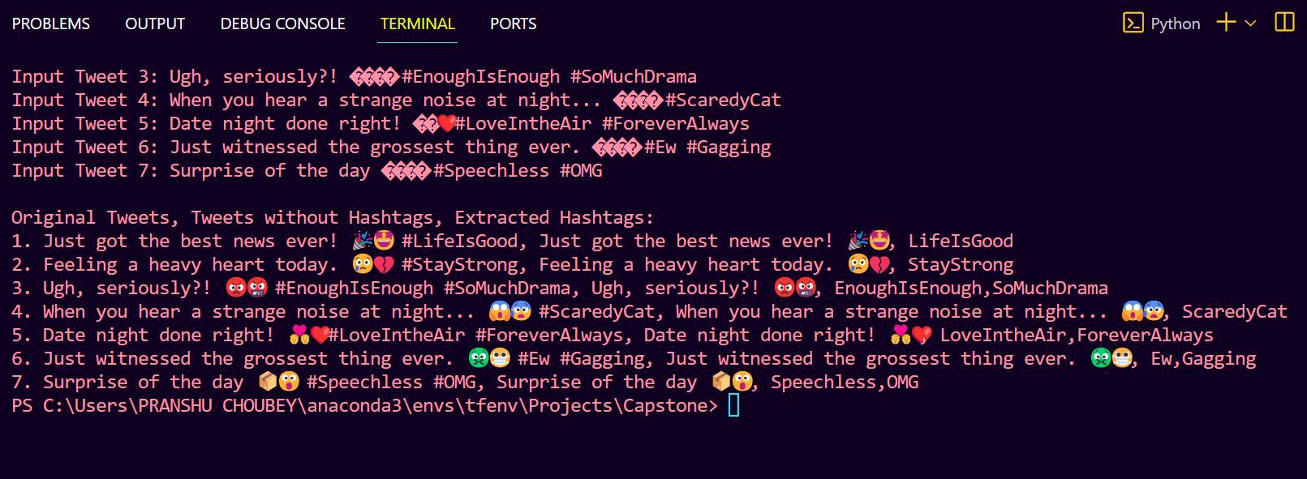
2.1 Hashtag (#) Extractor Sample Output:

Slide 16
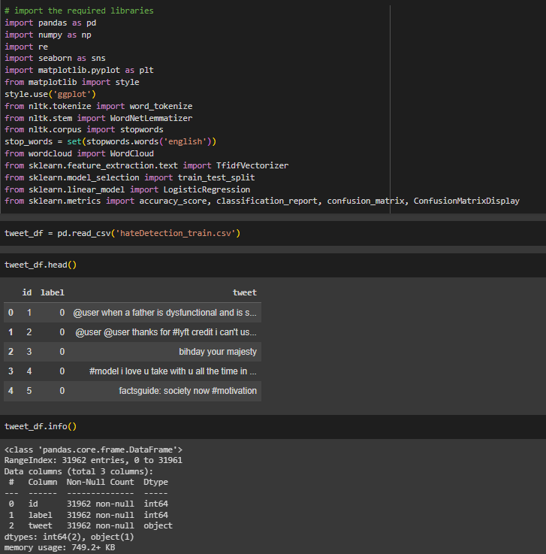
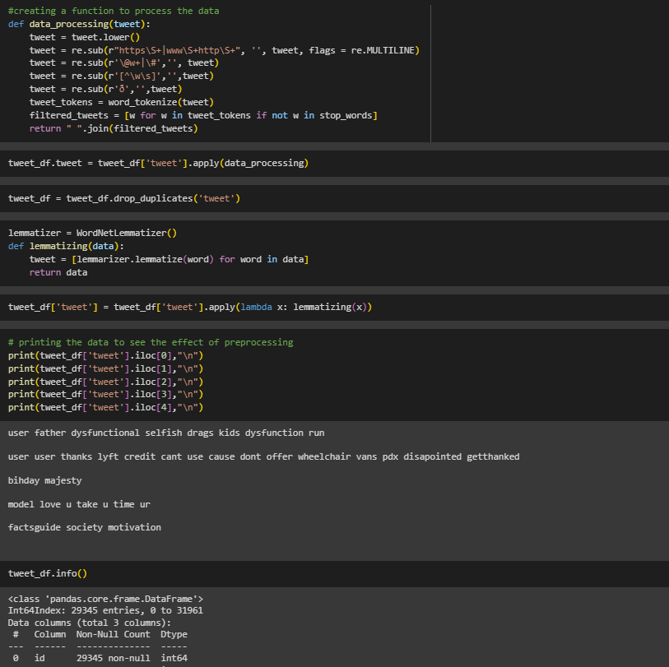
3.1 Hate Speech Detection from Twitter Data

Slide 17
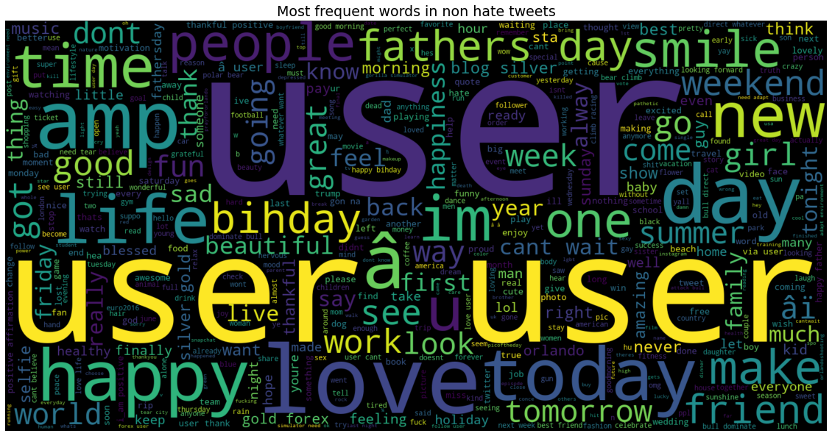
3.2 Most Frequent Words in Non-Hate Tweets:

Slide 18
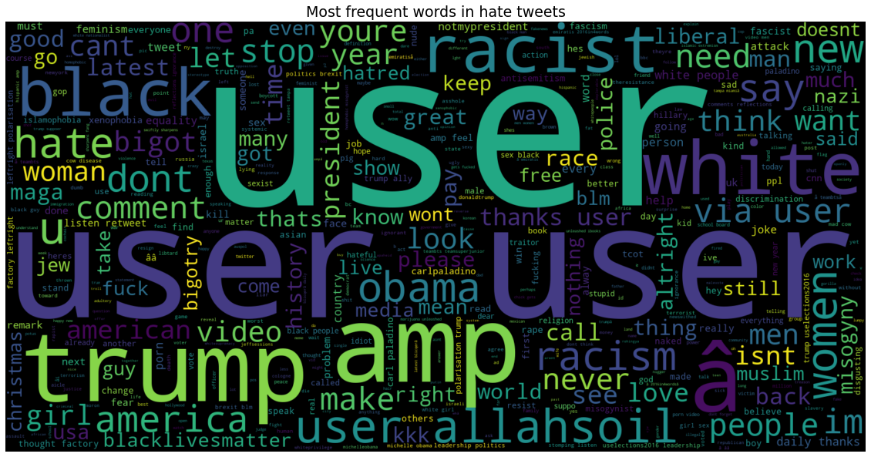
3.3 Most Frequent Words in Hate Tweets:

Slide 19
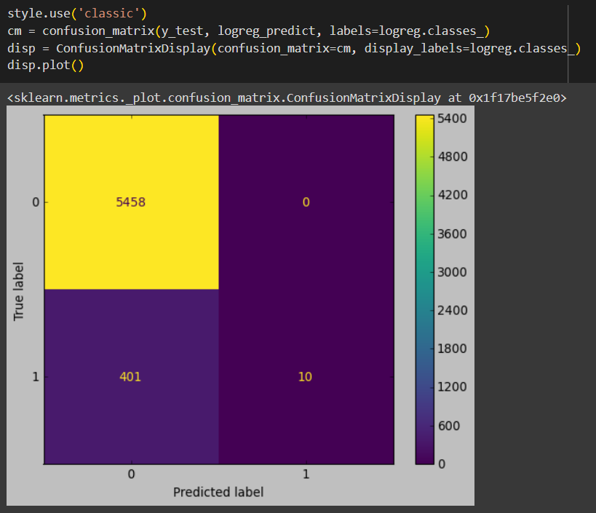
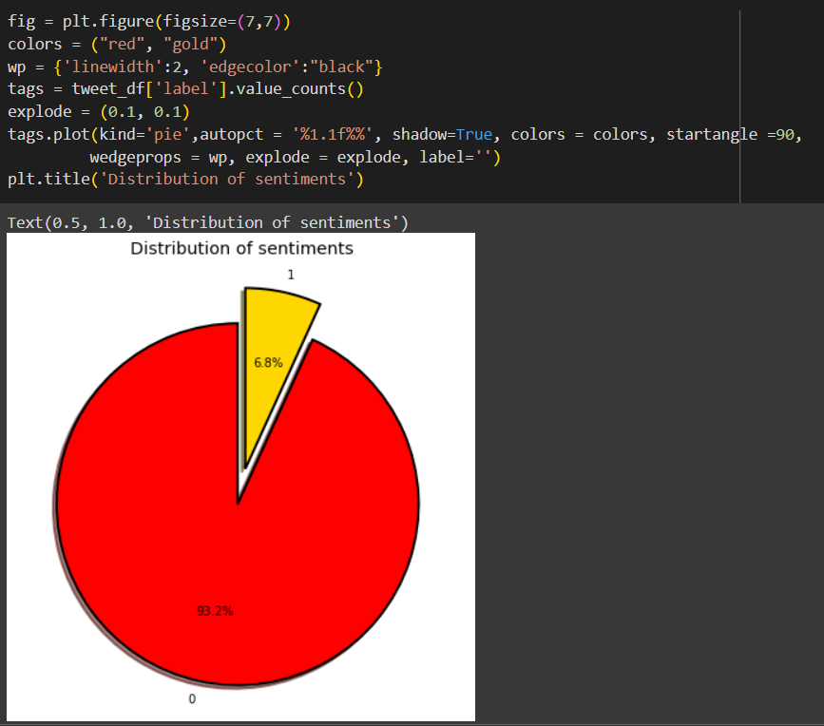
3.4 Data Visualization:

Slide 20
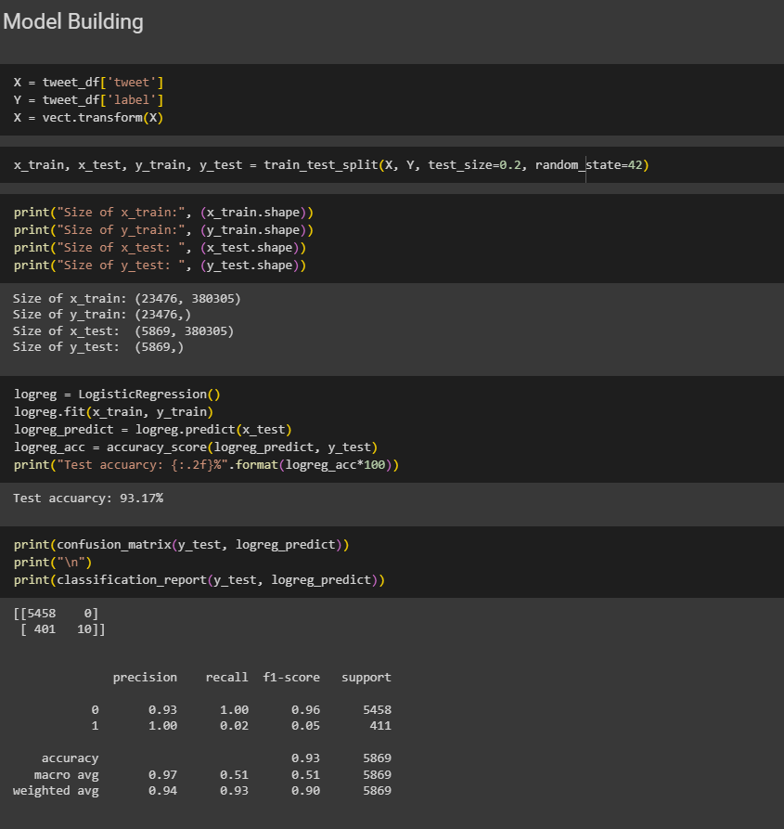
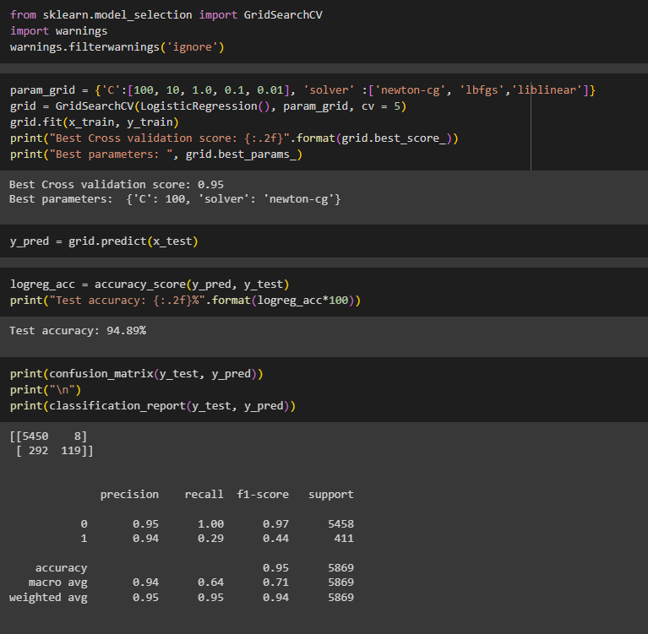
3.5 Model Building and Evaluation

Slide 21
Findings and Discussions:
The Logistic Regression model achieved an accuracy of 93.17% on the test data for hate speech detection.
GridSearchCV further improved the model performance, achieving a test accuracy of 94.89%.
Non-hate tweets contained more words related to life, thanks, happy while hate tweets contained words like misogyny, racism, hate indicating negative topics.
The model was able to correctly classify over 95% of the non-hate tweets but struggled with hate tweets, only predicting correctly 29% of the time.
Further hyperparameter tuning and use of deep learning models may help improve performance especially for identifying hate speech tweets.

Slide 22
What is to be done next?
Testing and Evaluation:
Conduct rigorous testing of each module individually and collectively to ensure functionality and coherence and evaluate the system's performance against diverse datasets.
Fine-tuning and Optimization:
Iteratively fine-tune the modules based on testing outcomes and feedback.
Optimize the system's parameters for efficiency and accuracy.
Documentation and Reporting:
Document the implementation process, including codebase and algorithms.
User Feedback and Iteration:
Gather user feedback through pilot testing and adjust the system accordingly.
Iterate on the system based on real-world usage and user experience.

Slide 23
References:
[1] Chuchu Liu a, Fan Fang, Xu Lin, Tie Cai, Xu Tan, Jianguo Liu, Xin Lu - “Improving sentiment analysis accuracy with emoji embedding.” Journal of Safety Science and Resilience pp. 246-252 - 2021
[2] Anatoliy Surikov, Evgeniia Egorova - “Alternative method sentiment analysis using emojis and emoticons” ScienceDirect pp. 182-193 - 2020
[3] Serkan Ayvaz, Mohammed O. Shiha - “The Effects of Emoji in Sentiment Analysis” International Journal of Computer Electrical Engineering pp. 360-369 - 2019
[4] Geetika Vashisht, Manisha Jailia - “Emoticons & Emojis Based Sentiment Analysis: The Last Two Decades!” INTERNATIONAL JOURNAL OF SCIENTIFIC & TECHNOLOGY pp. 639 - 645 - 2020
[5] Gaël Guibon, Magalie Ochs, Patrice Bellot - “From Emojis to Sentiment Analysis” Second Joint Conference on Lexical and Computational Semantics pp. 423- 430 - 2021
[6] Wieslaw Wolny - “Twitter Sentiment Analysis Using Emoticons and Emoji Ideograms” 25TH INTERNATIONAL CONFERENCE ON INFORMATION SYSTEMS DEVELOPMENT pp. 333- 342 - 2019
[7] V Jagadishwari, A Indulekha, Kiran Raghu and P Harshini - “Sentiment analysis of Social Media Text-Emoticon Post with Machine learning Models Contribution Title” Journal of Physics: Conference Series. DOI: 10.1088/1742-6596/2070/1/012079 - 2021

Slide 24
[8] Bhaskaran S; Veeramanickam M.R.M; S. Hariharan; N. Bharathiraja; Pradeepa K; Raja Marappan - “Sentiment Analysis Model using Text and Emoticons for Pharmaceutical & Healthcare Industries” Conference on Lexical and Computational Semantics. DOI: 10.1109/CISCT55310.2022.10046449 - 2023
[9] Haochen Zou, Kun Xiang - “Sentiment Classification Method Based on Blending of Emoticons and Short Texts” International Conference on Communication Systems & Networks (COMSNETS) pp. 398 - 415 - 2022
[10] Himanshu Sakode; T. Lakshmi Surekha; M. Divya Sri; G. Bharath Kumar - “Sentiment Analysis using Text And” Conference on Lexical and Computational Semantics pp. 268- 275 - 2023
[11] S. Ayvaz, Mohammed O. Shiha - “The Effects of Emoji in Sentiment Analysis” IEEE Transactions on Computational Social Systems pp. 360 -369 - 2021
[12] Deng Yang, Liu Kejian, Yang Cheng - “Emoji-based Fine-grained Attention Network for Sentiment Analysis in the Microblog Comments” IEEE Transactions on Computational Social Systems pp. 48-63 - 2022
[13] Sirisha Velampalli, Chandrashekar Muniyappa, Ashutosh Saxena - “Performance Evaluation of Sentiment Analysis on Text and Emoji Data Using End-to-End, Transfer Learning, Distributed and Explainable AI Models” Journal of Advances in Information Technology pp.167-172 - 2022
[14] V.Kavya, Mr.M.Swami Das - “Emoticons and Text Analysis as context to Sentiment Analysis” Journal of Emerging Technologies and Innovative Research (JETIR) pp. 87-90 - 2020
[15] Travis LeCompte - “Sentiment Analysis of Tweets Including Emoji Data” ACM Transactions on Software Engineering and Methodology pp. 202-250 - 2020

